Slide 1
Monthly Update — MEP Point Cloud Processing Using Deep Learning
YIN Chao
Department of Civil and Environmental Engineering
The Hong Kong University of Science and Technology (HKUST)
(Email: cyinac@connect.ust.hk )
3 Aug, 2019

Slide 2

Outline
MEPNet dataset V0.1
Segmentation Experiments on MEP(Taipo Scene) Using PointNet
HKUST HPC Cluster2 and Map Reduce
Future Plan

Slide 3
1. MEPNet dataset V0.1
Motivation
The key requirement for using supervised DL is the availability of a large labeled dataset. (e.g: ImageNet, ScanNet )
Objective of MEPNet benchmark dataset
A large set of point clouds with over a billion of labelled points
A common evaluation tool
[optional] A website to publish the benchmark where users can view basics of the dataset, download and submit their model results
Details of the dataset (Final version)
6 Categories (Tank, Pump, Filter, Valve, Pipe, Elbow)
15 labeled scenes for training set (each scene around 10 million points)
and 4 labeled scenes for test set
Notes:
http://www.semantic3d.net

Slide 4
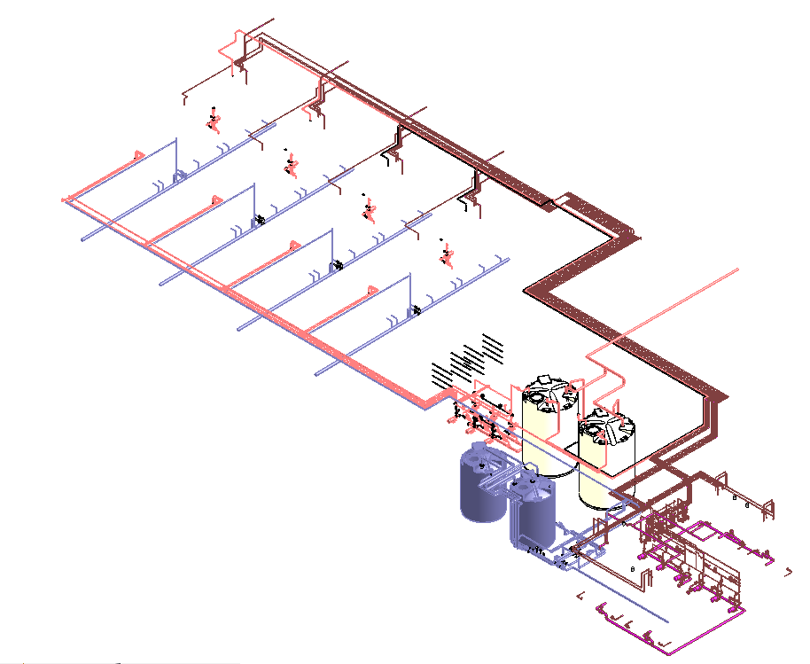
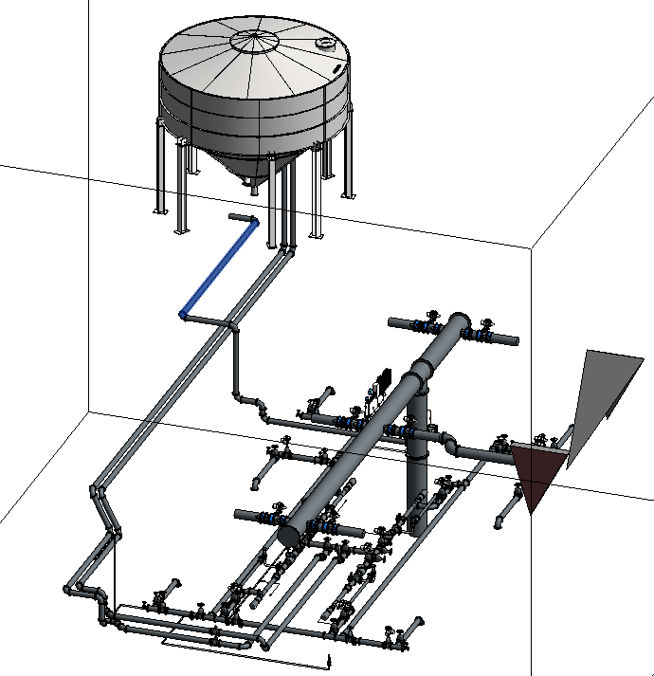
1. MEPNet dataset V0.1
Build MEPNet V0.1
1) Uniform labeled Point Clouds from BIM model
2 scenes, 6 categories
- Mesh (obj format) and Point Cloud ( txt, pcd,bin format)
- Utility code for data augmentation( e.g: scale, eliminate color, random dropout )
6 categories ( pipe,tank,pump,filter,valve,elbow )
4 categories( pipe,tank,pump,valve )
Notes:
However, the types in each category are limited. For instance, we only 1 type of filter and 2 types of tank after extension.

Slide 5
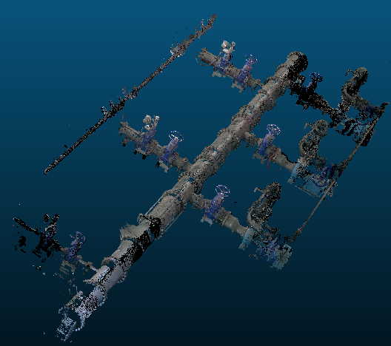
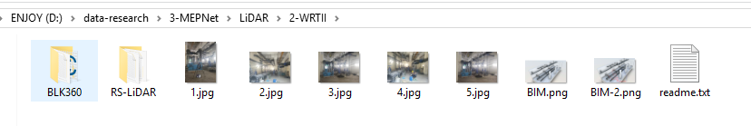
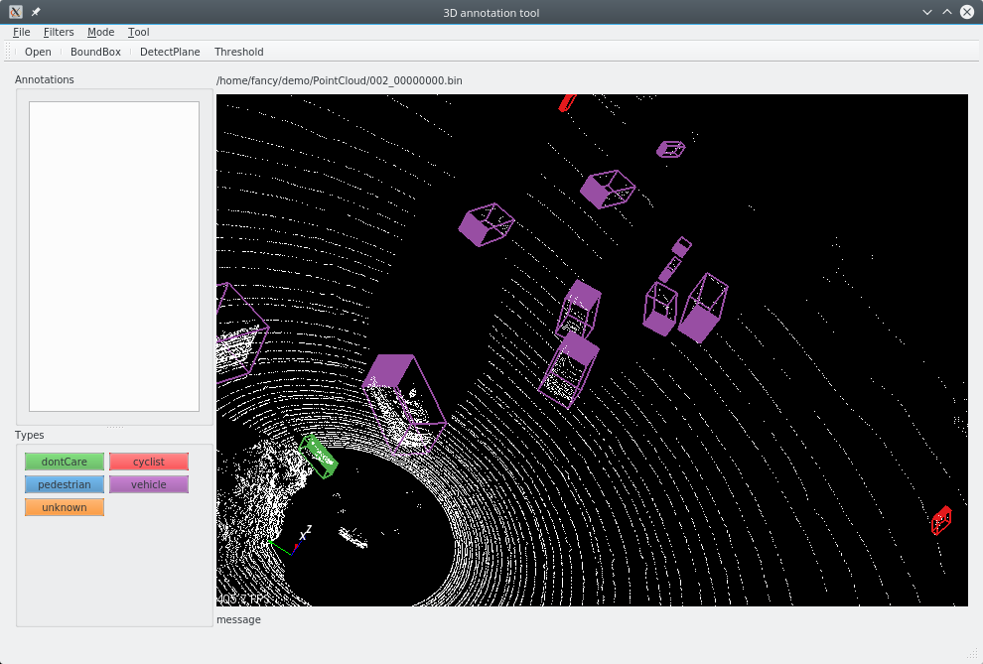
1. MEPNet dataset V0.1
Build MEPNet V0.1
2) Non-uniform labeled Point Clouds from laser scanner
10+ scenes, 6 categories
Annotation tool; cloucompare or build the tool using PCL1.8, QT and CMake tools.
https://github.com/springzfx/point-cloud-annotation-tool
Notes:
However, the types in each category are limited. For instance, we only 1 type of filter and 2 types of tank after extension.

Slide 6
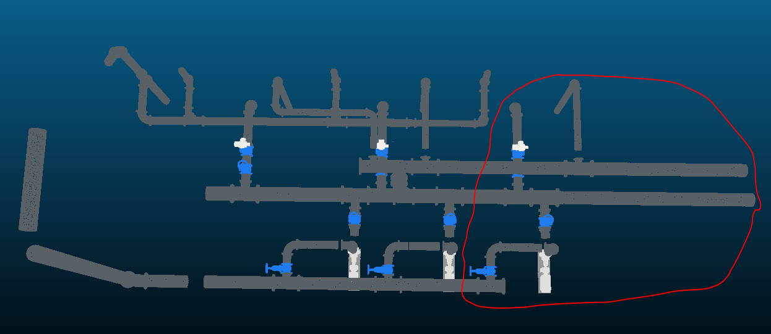
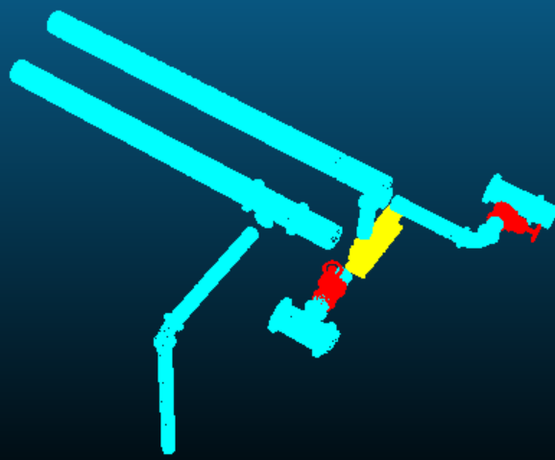
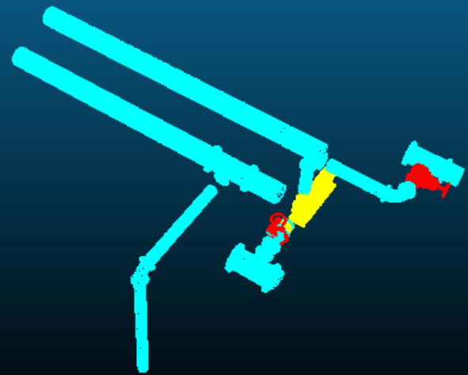
2.Segmentation Experiments on MEP(Taipo Scene)
1) Baseline ( semantic segmentation on MEP point cloud)
Train on BIM data, Test on BIM, BLK360 and RS-LiDAR
Qualitative results(On BIM data)
Pipe: light blue
Valve: red
Pump: yellow
Ground Truth
Predict results

Slide 7
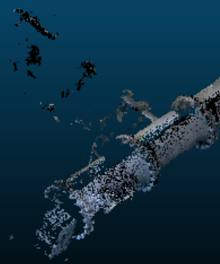
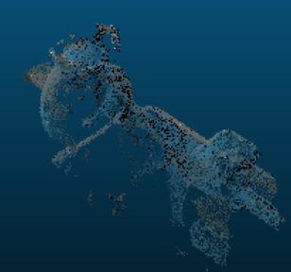
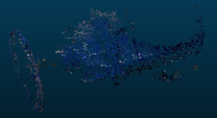
2.Segmentation Experiments on MEP(Taipo Scene)
Quantitative Results
Summary
Our model can generalize quite well w.r.t BIM-generated point cloud data which is uniform and complete.
Data mismatch issues; the data(BLK360/Rs-LiDAR) we’d like to predict has different data distribution from the BIM data. BLK360 or Rs-LiDAR data has suffered large noise, missing data ratio and outliers.
 | Accuracy | Mean IoU(pipe/valve/pump) | Type
BIM data I | 0.976 | 0.858(0.974/0.681/0.921) | Baseline
BLK360 | 0.597 | 0.227(0.680/0/0) | Baseline
RS-LiDAR | 0.458 | 0.183(0.472/0/0.076) | Baseline
Low quality
of BLK360 data
Notes:
Add more training data similar to BLK360/Rs-LiDAR data and make sure the scanned data quality is good.

Slide 8
2.Segmentation Experiments on MEP(Taipo Scene)
2) Data augmentation experiments
Missing data ratio (radomly)
Add Gaussian Noise (sigma=0.05,0.06,…0.1)
Both Gaussian noise and missing data
Transformation(rotate, scale, translate)

Slide 9
 | Accuracy | Mean IoU(pipe/valve/pump) | Type
BIM data I | 0.976 | 0.858(0.974/0.681/0.921) | Baseline
BLK360 | 0.597 | 0.227(0.680/0/0) | Baseline
RS-LiDAR | 0.458 | 0.183(0.472/0/0.076) | Baseline
BIM data I | 0.975 | 0.872(0.972/0.650/0.990) | DP(0.5)
BLK360 | 0.573 | 0.220(0.650/0.009/0) | DP(0.5)
RS-LiDAR | 0.434 | 0.175(0.446/0/0.08) | DP(0.5)
Baseline: train on BIM data
DP: randomly dropout
Noise: add Gaussian noise
Both: both DP and noise
Baseline(EX): Add BLK360 data
to the training set
BIM data I | 0.963 | 0.783(0.959/0.417/0.973) | Noise(0.05,0.01)
BLK360 | 0.635 | 0.239(0.717/0/0) | Noise(0.05,0.01)
RS-LiDAR | 0.566 | 0.219(0.592/0/0.065) | Noise(0.05,0.01)
BIM data I | 0.980 | 0.885(0.977/0.686/0.991) | Both
BLK360 | 0.553 | 0.210(0.631/0/0) | Both
RS-LiDAR | 0.447 | 0.179(0.462/0/0.074) | Both
BIM data I | 0.889 | 0.628(0.881/0.006/0.997) | Baseline(Ex)
BLK360 Test | 0.878(~28%up) | 0.803(0.830/0.661/0.917)(~60% up) | Baseline(Ex)
RS-LiDAR | 0.635(~7%up) | 0.274(0.637/0.147/0.041) (~6% up) | Baseline(Ex)

Slide 10
 | Accuracy | Mean IoU(pipe/valve/pump) | Type
BIM data I | 0.893 | 0.631(0.885/0.009/0.999) | Baseline
BLK360 Test | 0.867 | 0.789(0.816/0.633/0.917) | Baseline
RS-LiDAR | 0.636 | 0.287(0.624/0.227/0.008) | Baseline
Baseline: train on BIM data
DP: randomly dropout
Noise: add Gaussian noise
Both: both DP and noise
Baseline(EX): Add BLK360 data
to the training set
BIM data I | 0.973 | 0.849(0.970/0.690/0.887) | DP(0.5)
BLK360 Test | 0.841 | 0.681(0.787/0.614/0.639) | DP(0.5)
RS-LiDAR | 0.665 | 0.283(0.665/0.184/0) | DP(0.5)
BIM data I | 0.889 | 0.628(0.881/0.006/0.997) | Noise(0.05,0.01)
BLK360 Test | 0.878 | 0.803(0.830/0.661/0.917) | Noise(0.05,0.01)
RS-LiDAR | 0.635 | 0.274(0.637/0.147/0.041) | Noise(0.05,0.01)
BIM data I | 0.961 | 0.768 (0.957/0.580/0.767) | Both
BLK360 Test | 0.858 | 0.785(0.805/0.618/0.933) | Both
RS-LiDAR | 0.637 | 0.287(0.630/0.221/0.008) | Both
Notes:
BLK360 all(baseline)---better performance than BLK360 Test
Overall accuracy: 0.863
mean IoU:0.684
IoU:0.826,0.618,0.608
-----
BLK360 all(DP)---almost same with BLK360 Test
Overall accuracy: 0.862
mean IoU:0.682
IoU:0.824, 0.616, 0.606
-----
BLK360 all(noise)----acc almost same, but mIoU decreased.
Overall accuracy: 0.875
mean IoU:0.725
IoU:0.840,0.589, 0.746
-----
BLK360 all(both)--better
Overall accuracy: 0.892
mean IoU:0.806
IoU:0.855,0.607,0.955

Slide 11
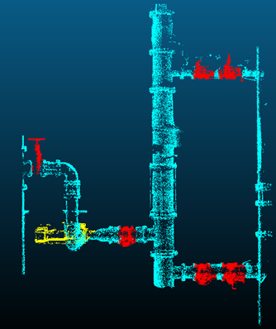
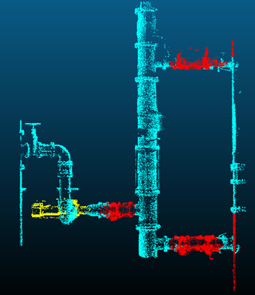
2.Segmentation Experiments on MEP(Taipo Scene)
3) Qualitative results of BLK360 data (Baseline (Ex))
The performance is quite good, but still not be capable to recognize small components or structures.(e.g: Valve).
Pipe: light blue
Valve: red
Pump: yellow
Ground Truth
Predict results

Slide 12
2.Segmentation Experiments on MEP(Taipo Scene)
4) Summary
PointNet model can generalize extremely well to the data which are representative to the training dataset (e.g.: train on BIM data and test on BIM data); Besides, Using data augmentation techniques(randomly dropout inputs and add Gaussian noise) can slightly improve the performance and contribute to boosting the some particular types’ segmentation performance like valve and pump data.
Regarding BLK360/Rs-lidar data, adding noise can help improve the performance by around 10%.
Regarding data mis-match issues, ensuring data in good quality by cleaning data(BLK360) and adding more representative data to the training dataset are two effective solutions.

Slide 13

3. HKUST HPC Cluster2
What is HPC Cluster2 ?
high-performance computing service.(PI member, and HKUSTer)
PI group.( 2TB/grp, 32CPUs, 4 GPUs-NVidia Tesla K80 )
How to use the cluster ?
How to set up the Deep learning development environment on the cluster?
Anaconda, g++, Singularity
CUDA and cuDNN
Create the Anaconda isolated environment.
Tensorflow-gpu and pytorch-gpu (Version issues)
Apply
Access
(SSH/Putty and Filezilla/WinSCP)
Perform jobs
On CentOS 6.x
(SLURM)
Notes:
A super-power computer with many cpus, gpus, and memories.
Computationally-expensive tasks

Slide 14
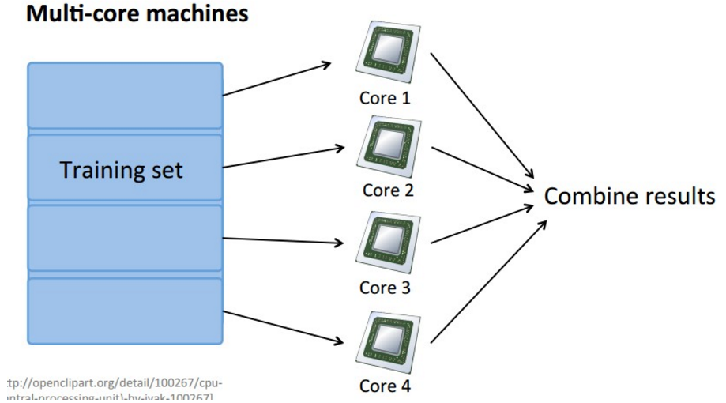
3. HKUST HPC Cluster2
How can I run program with multiple GPUs?
Map Reduce; distribute and parallel your big data sets over multiple computers or cores.
Merits: Speed up your deep learning GPU computation by many times.(e.g: 4 times) so that you can iterate your ideas rapidly. (ideas-code-analysis)
TensorFlow/Pytorch with multiple GPUs; take tensorflow as an example.
Parallelize your datasets over multiple GPUs or CPUs.
Notes:
a programming model and an associated implementation for processing and generating big data sets with a parallel, distributed algorithm on a cluster.(wiki)

Slide 15
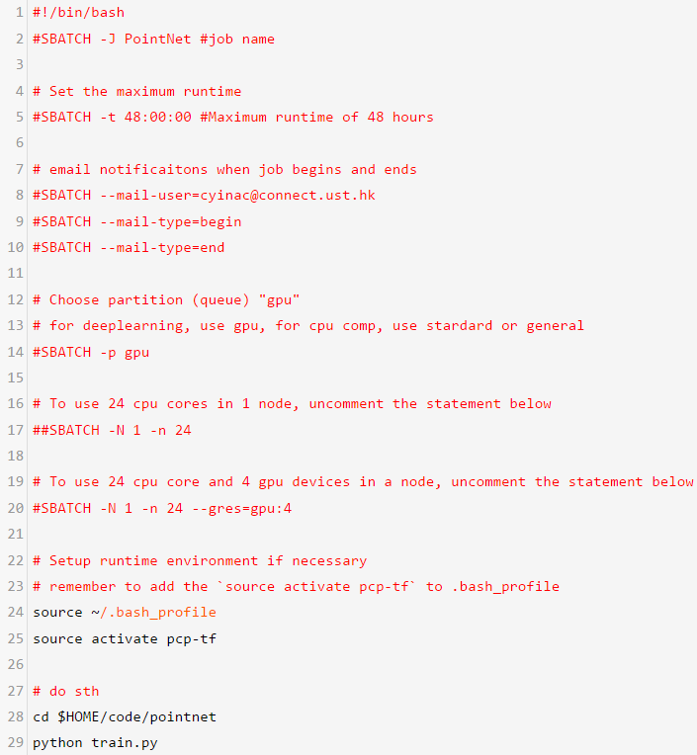

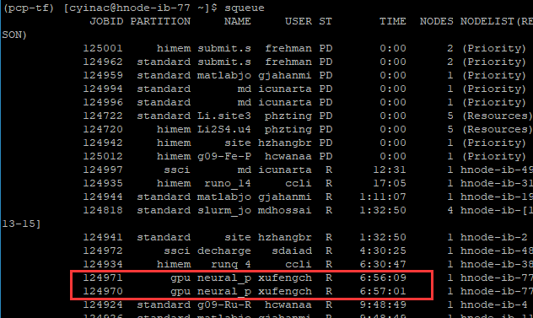
3. HKUST HPC Cluster2
How to run gpu/cpu jobs on the cluster?
All jobs in the cluster must be run with the SLURM(Simple Linux Utility for Resource Management).
3 steps: 1) prepare your app. 2)SLURM script(key)3)submit it.
Example: how to run the pointnet on the cluster?
Submit the script to SLURM
SLURM script:
Pointnet.cmd
Check SLURM jobs

Slide 16
4. Future Plan
Dataset
Label more point cloud data
Upgrade MEPNet benchmark dataset to V0.2
Model
Fine-tune PointNet on MEP data for better performance
Rs-LiDAR fly optimal setting test
Notes:
https://en.wikipedia.org/wiki/MapReduce
Apply Map Reduce ideas to speed up my segmentation experiments

